Slide 1
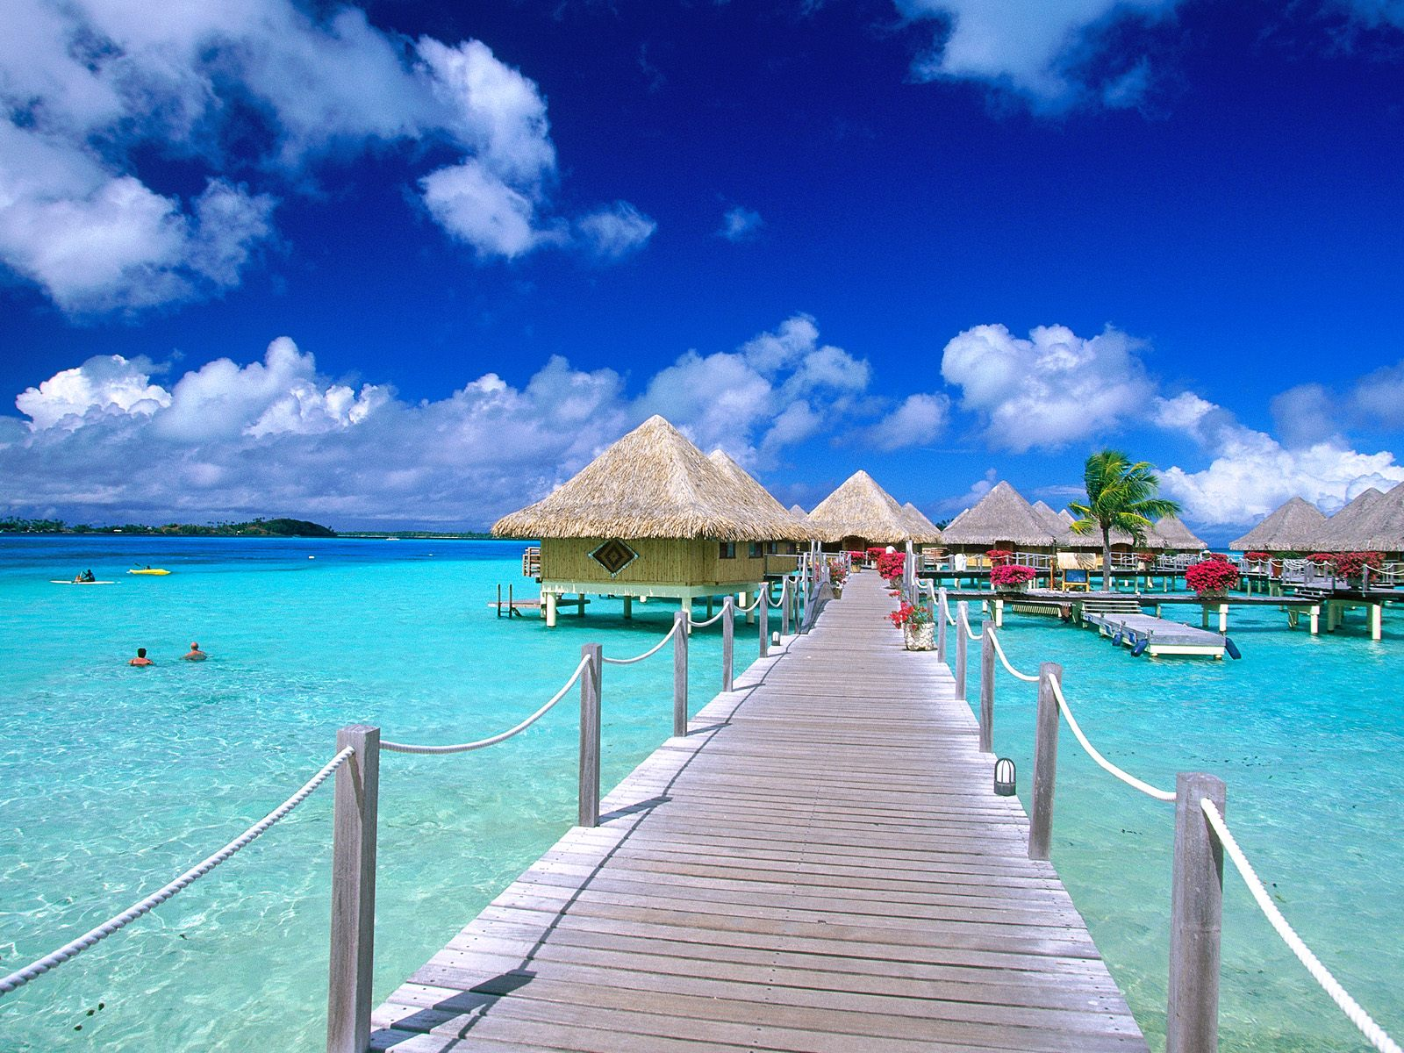
ELEMENTS OF TOURISM

Slide 2
Elements of tourism refer to the basic fundamentals without which tourism activity of any kind is not possible.
They form the base of tourism and all tourism activities are possible due to them.
These elements are the fundamental attractions of tourism. They are
  1. Pleasing weather
  2. Scenic attractions
  3. Historic and cultural factors
  4. Accessibility
  5. Amenities
  6. Accommodation

Slide 3
1. Pleasing weather
One of the crucial attractions of any tourist place is fine weather with warm sunshine.
Good weather play an important role in making a holiday pleasant experience.
Millions of people from countries with extremes of weather visit sea beaches in search of fine weather and sunshine.
Development of spas and resorts along the seacoasts in many countries were a result of travelers urge to enjoy good weather and sunshine.
example : Beaches of Goa, Hawaii Island in USA .
Areas with attractive winter climates, warmth and sunshine are important centers of tourist attractions. Example Gulmarg in Jammu and Kashmir .
In countries with tropical climates many upland cool areas have been developed as hill station resorts. Example Munnar, Assam in India.

Slide 4
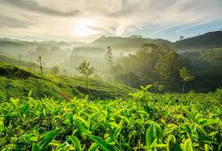

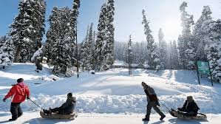

Slide 5
2. Scenic attractions
Scenic attractions with good weather are very important factors in tourism.
Scenery consisting of mountains, lakes, waterfalls, glaciers, forests, deserts, coral reefs etc are strong forces attracting people to visit them.
Some of the examples are northern slopes of the Alps in Switzerland, Himalayan mountains, great natural wonders such as the grand canyon in US, the Niagara falls, the forest of Africa that attracts millions of tourists.

Slide 6
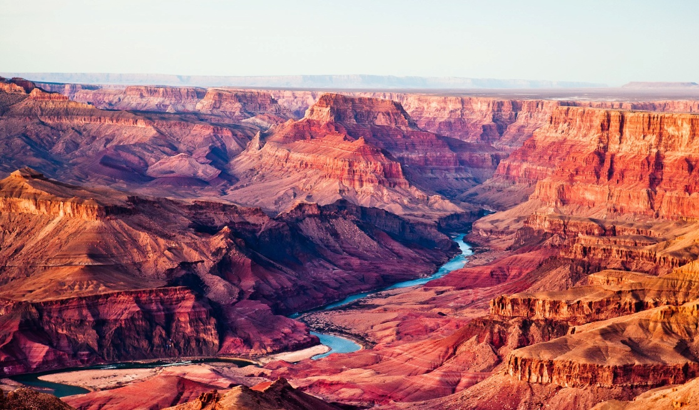
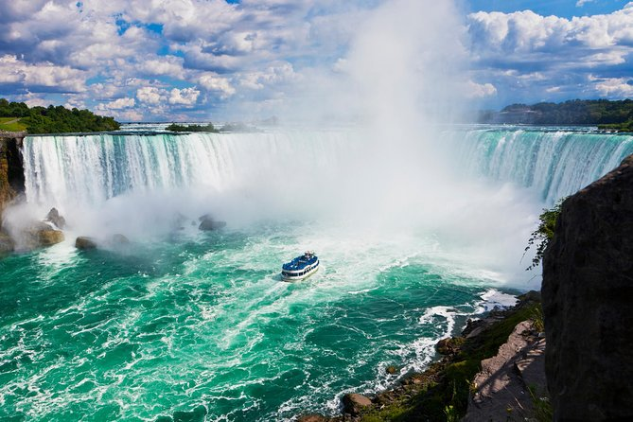
Grand Canyon in Arizona, USA
Niagara falls, (Border of New York, United States, and Ontario, Canada)

Slide 7
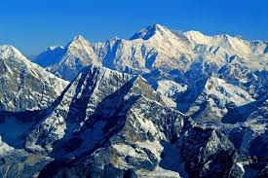
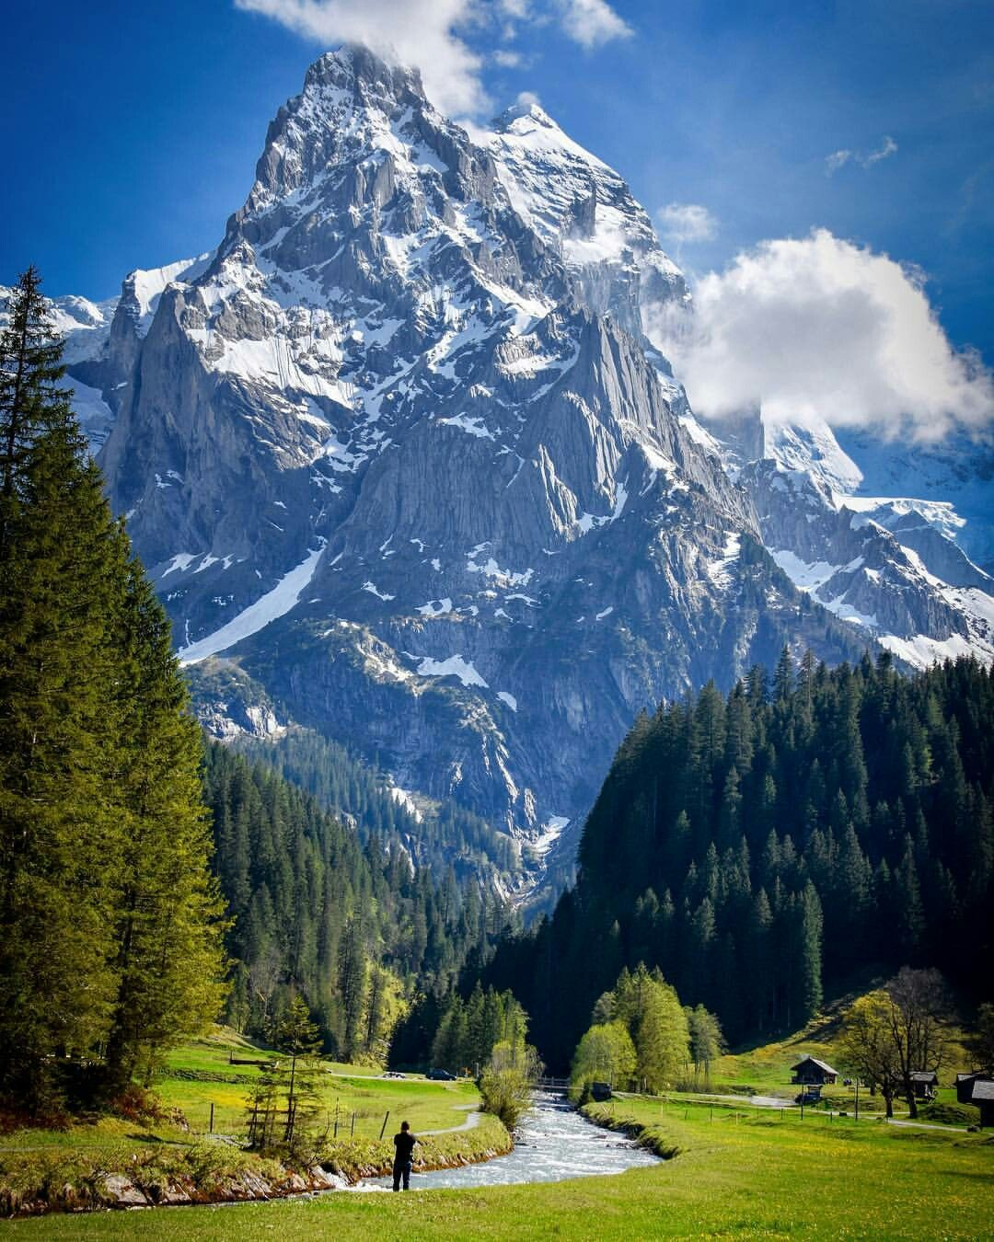

Himalayan Mountains and Alps Mountain in Switzerland.
Coral reefs in Lakshadweep

Slide 8
3.Historical and cultural factors
Characteristics of historical and cultural interest exert a powerful attraction for many.
Large number of tourists are attracted the city of agra in india because of its famous Taj Mahal.
Thousands of Americans and Canadians visits Europe because of its long historical heritage.
Many countries which are developing tourist industries are using the legacy of their historical past as their major tourist attraction.
For example , Ajanta and Ellora caves in india are the oldest and most beautiful testimony of religious architecture and painting.
The cultural art forms like kathakali , koodiyattam and the traditional medicine Ayurveda etc paves way for developing cultural tourism in India

Slide 9
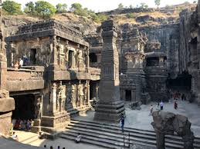
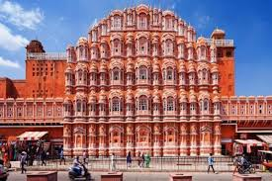
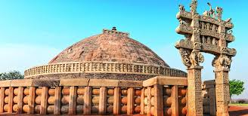
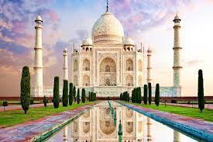
Ajanta Ellora caves Hawa Mahal
Sanji stupa Taj mahal

Slide 10
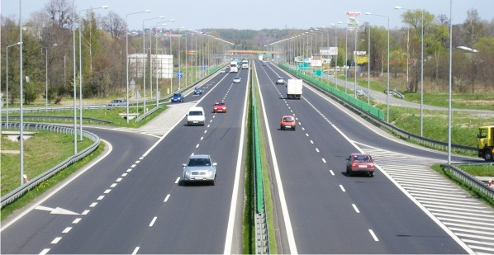
4. Accessibility
It is mean by which a tourist can reach the area where attractions are located.
Tourist attractions of whatever type would be of little importance if their locations are inaccessible by the normal means of transport.
Tourist attractions which are located near to the tourist generating markets and are linked by a network of efficient roads and can be easily reached by various modes of transportation and receive the maximum number of tourists.

Slide 11
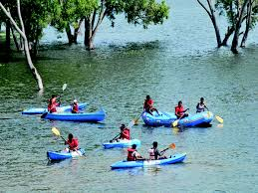
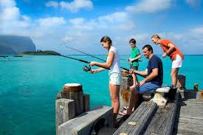
5. Amenities
Basic facilities and services provided to the tourist in a destination.
They play an important role in shaping the visitor experience and include things like public restrooms, connectivity, emergency services, postal facilities, roads, sidewalks, safe drinking water, restaurants, sanitary, electricity, communication network, banks etc.
For a seaside resort facilities like swimming, boating, diving, surfing etc. make the trip attractive.

Slide 12

6. Accommodation
Accommodation is very basic to any tourist destinations.
There are number of type and categories of accommodation units ranging from budget to the highly facilitated.
There has been a growing demand for more informal types of accommodation like holiday villages, camping and caravan sites, tree houses, traditional accommodations etc.

Slide 13
END

