Slide 1
Components of tourism

Slide 2
Definition of tourism
Tourism comprise the activities of persons traveling to staying in places out side their usual environment for not more than one consecutive year for the purpose of leisure, business and other purposes.

Slide 3
Components of Tourism (5 A’s of tourism)
The success of a tourist destination depends upon the interrelationship of the following five ‘A’ factors:
Accessibility
Accommodation
Attractions
Amenities
Activities
Developing a suitable combination of these factors is at the heart of tourism planning.

Slide 4
Accessibility
If the tourist attractions are located at places where no transport can reach or where there are inadequate transport facilities, these become of little value.
Accessibility means reachability to the place of destination through various means of transportation.
The different modes of transportations are rail, road, air and water
Transportation should be regular, comfortable, economical and safe.
Sometimes modes of transport can be attractions in their own right. Ferries, steam trains and scenic roads with viewing areas both provide access and can be attractions in themselves

Slide 5
Water Travel
The Duke of Bridgewater is believed to be the initiator of water transport service between Manchester and London Bridge in 1772. These are market boats and used to pick up passengers as well as goods on ship canals in England. By 1815, steamship emerged and gradually steamship excursions on Themes became so popular. Now, the popular modes of water transportation include, 1) Cruises (Ocean and River), Safari boats, House boats etc.
Rail Travel
Indian Railways is the third largest rail network in the world, and the rail system is efficient, if not always on schedule. Indian Railways operate a number of luxury trains for the purpose of tourists who are interested to explore Indian destinations. These are operated by different state tourism development corporations in collaboration with the Indian railways. The major tourist trains include: Palace on Wheels, Deccan Odyssey, Golden Chariot, Maharaja’s Express, Royal Rajasthan on Wheels etc.
Motor coach
Now, the most popular way of transport is being used widely by the public for travel and holidaying due to its special significance to the mankind.
Air Transport
The introduction of Boeing and Jet series of aircrafts democratized and popularized the air travel among the general public as well. The speed and efficiency of aircrafts facilitated the travelers to cover distant lands in short period. Air travel in the world is growing at speed of 5% yearly. Liberalization and privatization policies in air transport given an abundant opportunity for so many private carriers to enter to the market.

Slide 6
Accommodation
It is a place where tourists can find food and shelter provided he/she is in a fit position to pay for it.
There are various types of accommodation from a seven star deluxe hotel to a normal budget class hotel.
A variety in style and quality of accommodation in a region provides an important means to increase the economic impact of visitors.
Normally accommodation is classified into two
Primary accommodation
Secondary accommodation

Slide 7
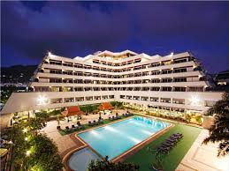
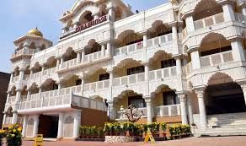
Primary accommodation
It is the place where travellers can get accommodation as well as all other facilities.
Example : Hotel, Resort, Heritage hotels

Slide 8
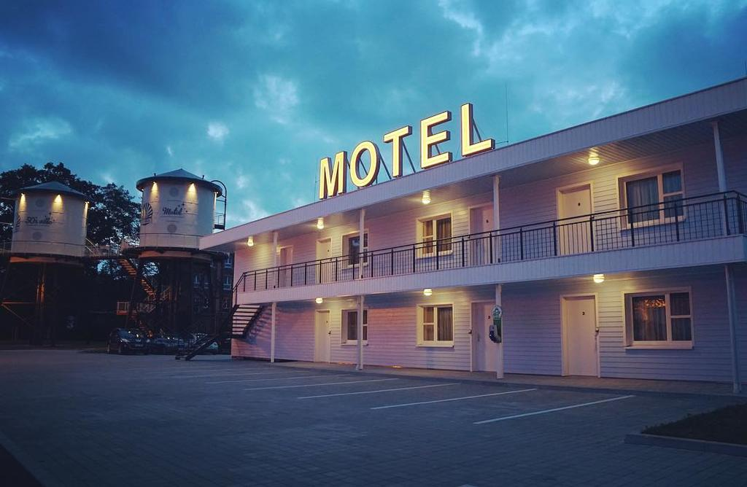
Which provide accommodation but not the services of Hotel
Example: Motels, Holiday centre, Forest lodges, Dharmasalas, Youth hostels etc
Secondary accommodation/ Supplementary accommodation.

Slide 9
Attractions
Attraction are the reason for visit to any place.
It is a place of interest where tourists visit, typically for its exhibited cultural value, historical significance, natural or built beauty, or amusement opportunities.
The other constituents of the tourism industry such as accommodation, transport, food and beverage, etc. depend on the existence of attractions at the destination for their survival.

Slide 10
Types of attractions
Natural attractions
Manmade attractions
These attractions are completely natural and include mountains, rivers, lakes, national parks, beaches, deserts and anything which has not been made by man.
These are products of history and culture .
Types of manmade attractions include museums, galleries, statues, castles and buildings, shopping and leisure centres, theatres and sporting venues.

Slide 11
The attractions are again classified into two. They are :
Site attraction
Event attraction
Alps, mountain, Himalayas, water falls at Niagara
Camel festival, boat festival at Kerala etc

Slide 12
Peters inventory of tourism attractions are:
As interests and tastes vary from man to man, the tourists might make the selection out of the wide range of attractions available at various tourist spots all over the world. Peters has drawn up an inventory of the various attractions which are significance in tourism. They are:
Cultural
It is the ideas, customs and social behaviour of a particular social group.
Example: Sites and areas of archaeological interest, historical buildings and monuments, museums, religious institutions etc.
2. Traditions
It is the transmission of customs and belief of one generation to another.
Example: National festivals, arts and handicraft , music, folklore, life and customs.
3. Scenic
National parks, wildlife, flora and fauna, beach resorts, mountain resorts.
4. Entertainment
Participation and viewing sports, museum and recreation parks, cinemas and theatre, zoos and aquariums, cusine, nightlife etc

Slide 13
Amenities
Basic facilities provided in a tourist destination . Amenities are the services that are required to meet the needs of tourists during their visit to a destination.
Retail Shops
Restaurants and Cafés
Public toilet
Public transport
Tourist information desk
Telecommunications,
Emergency services
Drinking water

Slide 14
Activities
The various element of tourism services available which offer to tourist at the destination. Activities provide entertaining diversions for people once they are in the area. Activities add variety and can make a visit more enjoyable.
Trekking
Bird watching
Sailing
Sports
Traditional music/ dance performance

Slide 15
Thank you

